Slide 1
Analysis and Design of Algorithms
ENCS202
Unit-1
Introduction to Algorithms
Session-2: Analysis of algorithm (Asymptotic analysis of complexity bounds – best, average and worst-case behaviour)
Dr. Vandna Batra

Slide 2
Learning Outcomes
Explain the need for asymptotic analysis
Distinguish between Big-O, Ω, Θ, o, and ω
Analyze algorithm growth using best, average, and worst cases

Slide 3
From Algorithm to Analysis
Session-1 focused on what an algorithm is
Session-2 focuses on how good an algorithm is
Correct algorithms may differ in efficiency

Slide 4
Analysis of an Algorithm
Algorithm analysis is an important part of computational complexity theory.
It provides theoretical estimation for the required resources of an algorithm to solve a specific computational problem.
"If two algorithms solve the same problem correctly,
how do we choose one?”

Slide 5
Why Not Measure Actual Running Time?
Depends on machine and compiler
Depends on programming language
Depends on input values
➡️ Leads naturally to Asymptotic Analysis

Slide 6
Asymptotic Analysis of Algorithms
What Asymptotic Analysis Does
Studies growth rate w.r.t input size
(we don’t measure the actual running time)
Ignores machine-dependent factors
Focuses on large inputs

Slide 7
Asymptotic Analysis of Algorithms
What It Helps Us Do
Compare algorithms
Predict scalability
Choose efficient solutions
Asymptotic Analysis is not perfect,
but that’s the best way available for analyzing algorithms

Slide 8
Complexity of an Algorithm
1.Time Complexity
Running time of the program as a function of the size of input
2. Space Complexity
Amount of computer memory required during the program execution, as a function of the input size.

Slide 9
Time Complexity
Time T(P) taken by a program is the sum of the Compile Time and Run(or Execution) time.
Program once compiled can be run several times.
Compile time doesn’t depend on instance characteristics.
Time complexity measures the amount of time an algorithm takes to complete as a function of the input size n.
It reflects the growth rate of the number of operations as input size increases.

Slide 10
Types of Time Complexity
Best Case: The minimum time required for an algorithm to complete (optimistic scenario).
Worst Case: The maximum time required (pessimistic scenario).
Average Case: The expected time for a random input of size n.

Slide 11
Types of Time Complexity
Searching an element in a list
Best: found at first position
Worst: found at last position
Average: somewhere in between

Slide 12
Asymptotic Analysis
There are three most common types of asymptotic notations:
Big O Notation (O): Describes the upper bound of the runtime, indicating the worst-case scenario.
Omega Notation (Ω): Represents the lower bound, indicating the best-case scenario.
Theta Notation (Θ): Indicates a tight bound, meaning the algorithm's runtime grows at the same rate in both the upper and lower bounds.
Other two:
Little Oh (o)
Little Omega (w)

Slide 13
Idea of Upper Bound (Big-O)
Big-O notation tells us:
How fast an algorithm can grow in the worst case
The maximum number of steps an algorithm may take
How performance changes when input size increases

Slide 14
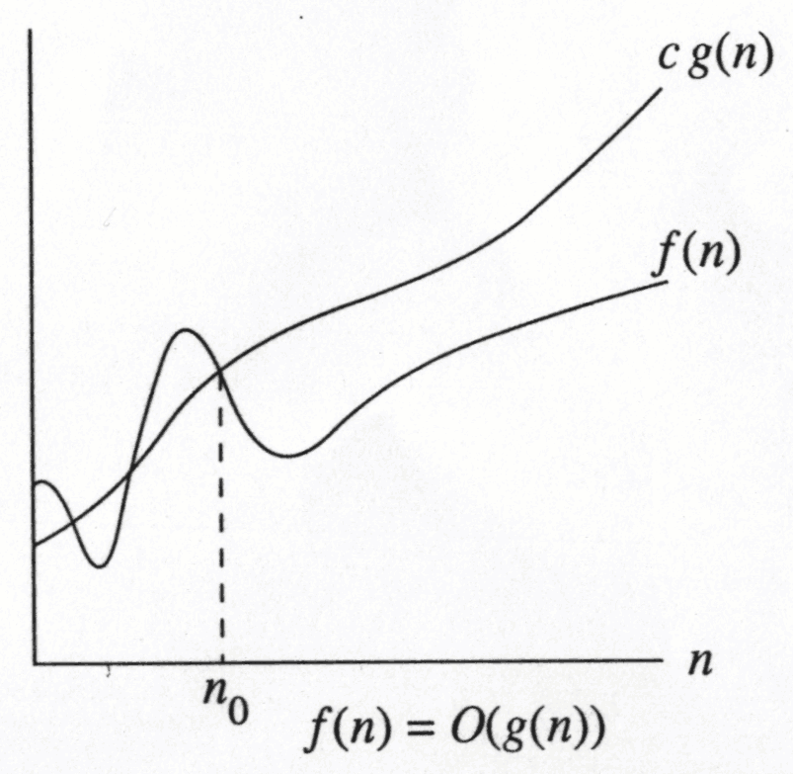
Formal Definition of Big-O Notation
Big-O is an Asymptotic Notation for the worst case
It provides us with an asymptotic upper bound for the growth rate of runtime of an algorithm
Say f(n) is your algorithm runtime, and g(n) is an arbitrary time complexity you are trying to relate to your algorithm.
f(n) is O(g(n)), if for some real constants c (c > 0) and n₀,
Such that f(n) <= c g(n) for every input size n (n > n₀).
f(n) grows no faster than g(n) for “large” n
g(n) defines an upper bound on f(n)

Slide 15
Big-O notation example
f(n) = 2n + 3
Step 1: Identify dominant term
Dominant term = n
Step 2: Ignore constants and lower-order terms
2n + 3 → n
Step 3: Write Big-O
f(n) = O(n)

Slide 16
Try-It Question
f(n) = 5n² + 20n + 10
Questions:
What is the dominant term?
Which terms can be ignored?
What is the Big-O notation?

Slide 17
Try-It Question
f(n) = 5n² + 20n + 10
Dominant term: n²
Ignore: constants and lower-order terms
Final answer:
f(n) = O(n²)

Slide 18
Big-O Notation
Examples:
If f(n)=2n+3 is your algorithm runtime ,
Can we write f(n)=O(n)?
f(n) = 3*n^2 and g(n) = n;
Is f(n)=O(n)?
2n + 3 is O(n) and 5n is O(n);
place 2n + 3 and 5n in the same category
Big-Oh allows us to ignore constant factors and lower order (or less dominant) terms

Slide 19
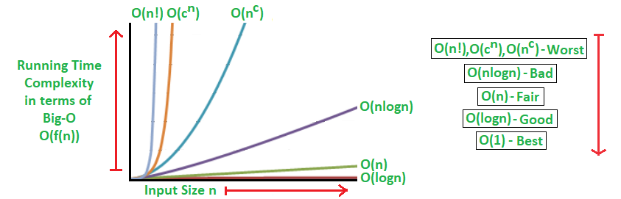
Common Asymptotic notations & comparison
constant | Ο(1)
logarithmic | Ο(log n)
linear | Ο(n)
n log n | Ο(n log n)
quadratic | Ο(n²)
cubic | Ο(n³)
polynomial | n^{Ο(1)}
exponential | 2^{Ο(n)}
One should remember the general order of following functions.
O(1) < O(logn) < O( n) < O( nlogn)< O(n*n) < O(n*n*n) < O(n^{k})< O(2^{n})

Slide 20
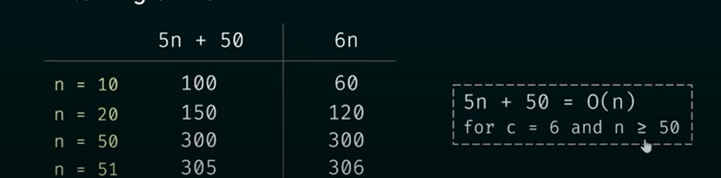
Big-O Notation example
Example 1 : Assume that f(n)= 5n+50 and g(n) = n
Is f(n)=O g(n) ???
Solution : We know f(n) <= c g(n) Assume c=6
Why c=6 ???

Slide 21
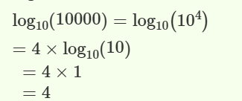
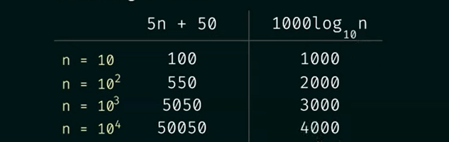
Big-O Notation example
Example 2 : : Assume that f(n)= 5n+50 and g(n) = log ₁₀ n Is f(n)=O g(n) ???
Solution : We know f(n) <= c g(n) Assume c=1000 g(n) is not upper bound

Slide 22
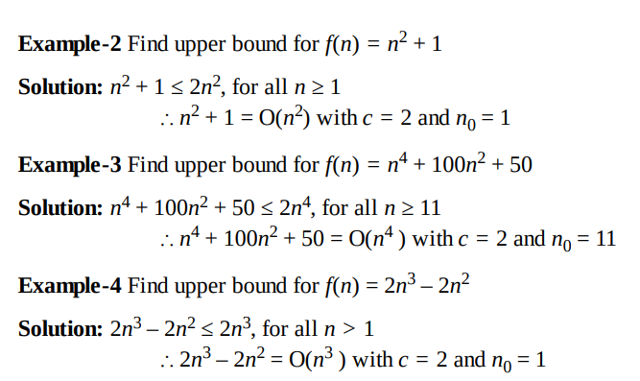
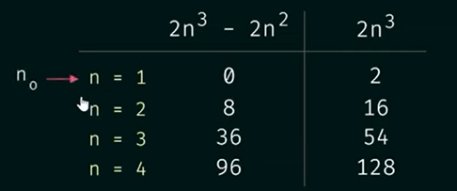

Big-O Notation Practice Questions

Slide 23
Little-o (ο) Notation
Little-o notation describes a strict upper bound.
f(n) grows strictly slower than g(n)
f(n) becomes negligible compared to g(n) for large n
Stronger condition than Big-O
Key idea:
Big-O allows equality, Little-o does not.

Slide 24
Little ο asymptotic notation formal definition
Big-Ο is used as a tight upper-bound on the growth of an algorithm’s effort.
“Little-ο” (ο()) notation is used to describe an upper-bound that cannot be tight.
Definition : Let f(n) and g(n) be functions that map positive integers to positive real numbers.
We say that f(n) is ο(g(n)) if for any real constant c > 0, there exists an integer constant n0 ≥ 1 such that 0 ≤ f(n) < c*g(n).
f(n) = o(g(n)) means lim f(n)/g(n) = 0 n→∞
For big Oh: true for at least one constant c
For little o: true for all constant c
Big-O is an inclusive upper bound, while little-o is a strict upper bound.

Slide 25
Summary
In this session, we learned:
Why actual running time is not reliable
Role of asymptotic analysis
Big-O as an upper bound
Little-o as a strict upper bound
Importance of focusing on growth rate
Key takeaway: Efficiency is about scaling, not speed.

Slide 26
Test Your Knowledge
Is 3n + 5 = O(n)?
Is n = o(n²)?
Is n² = o(n²)?
Which grows faster: logn or n?

Slide 27
Test Your Knowledge(Practice Questions
Q 1. Consider the following three claims
(n + k)^{m} = Θ(n^{m}), where k and m are constants
2^{n + 1} = O(2^{n})
2^{2n + 1} = O(2^{n})
Which of these claims are correct ?
(A) 1 and 2 (B) 1 and 3 (C) 2 and 3 (D) 1, 2, and 3

Slide 28
Test Your Knowledge
Answer: (A) Explanation: (n + k)^{m} and Θ(n^{m}) are asymptotically same as theta notation can always be written by taking the leading order term in a polynomial expression.
2^{n + 1} and O(2^{n}) are also asymptotically same as 2^{n + 1} can be written as 2 * 2^{n} and constant multiplication/addition doesn’t matter in theta notation.
2^{2n + 1} and O(2^{n}) are not same as constant is in power.

Slide 29
Test Your Knowledge
Q-2) Is 3 log n + 100 = O(log n)?
Q-3) If f(n) = 3*n^2 and g(n) = n , then f(n)= O(g(n))?
Q-4) Suppose you have algorithms with the five running times listed below. How much slower do each of these algorithms get when you (a) double the input size, or (b) increase the input size by one?
1. n2 ;
2. n3 ;
3. 100n2 ;
4. nlog(n);
5. 2n

Slide 30
Test Your Knowledge
Q 3. If f(n) = n+2, Can we write f(n)=O(n²⁾ ?
Q 4. f(n) = 3n² + 4n + 1. Show f(n) is O(n²)
Q 5. f(n) = 10n + 5 and g(n) = n show that f(n) is O(g(n))

Slide 31
Test Your Knowledge
State True or False
Q.6. 3n^2 + 10 n log n = O(n log n)
Q.7. 3 n^2 + 10 n log n = Omega(n^2)
Q.18. 3 n^2 + 10 n log n = Theta(n^2)

Slide 32
References
Textbooks
Cormen, Leiserson, Rivest, Stein (CLRS) – Introduction to Algorithms, Chapter on Asymptotic Notation
Ellis Horowitz, Sartaj Sahni – Fundamentals of Computer Algorithms
Online Resources
GeeksforGeeks – Asymptotic Analysis https://www.geeksforgeeks.org/analysis-of-algorithms-set-4-analysis-of-loops/
TutorialsPoint – Asymptotic Notations https://www.tutorialspoint.com/data_structures_algorithms/asymptotic_analysis.htm
Wikipedia – Big-O Notation https://en.wikipedia.org/wiki/Big_O_notation
Interview Cake – Big-O Simplified https://www.interviewcake.com/article/java/big-o-notation-time-and-space-complexity
CMU Lecture Notes – Complexity Analysis https://www.cs.cmu.edu
CodeProject – Time Complexity & Asymptotic Notations https://www.codeproject.com/Articles/1012287/Time-Complexity-Asymptotic-Notations

